Slide 1
ASP.NET

Slide 2
Introduction to ASP.NET 4.5
ASP.NET is a Web application framework marketed by Microsoft that can be used to build dynamic Web sites, Web applications, and XML Web services
Applications developed using ASP.NET must be hosted on an Internet Information Services (IIS) server
Notes:
Microsoft has developed ASP.NET which is a Web Development platform used to create web based applications. There are various versions of ASP.NET which has been released till date starting from ASP.NET 1.0 to ASP.NET 4.6. The framework is designed to work with HTTP Protocol which is the standard protocol used across all web applications. These ASP.NET web applications can be created in many languages which includes C#, VB.NET and J#. We could make a note of the full form of ASP which is Active Server Pages.
We can create the following types of Applications using the templates of ASP.NET:
Web Forms
Dynamic web pages can be created with Asp.NET Web Forms which uses the familiar method of Drag and Drop. It uses the Event Driven Model which helps us to write our logic in a tightly coupled manner. Since Web forms have a rich set of tool box, it helps us to build sophisticated, powerful UI Driven sites which can have good access to data.
MVC
The most powerful and pattern based way to create a dynamic web page is using MVC. The core advantage of using MVC is the Separation of Concerns, which gives us the full clarity and control over the HTML views, the controller logic and the models. MVC is considered to follow a front controller approach which has all the logical methods to be written in a controller. These methods can be invoked for multiple events unlike the tightly coupled methods of ASP.NET. Hence the methods of MVC are loosely coupled which makes the code reusable to a greater extent.
ASP.NET Web Pages
For a very quick and easy way of creating a Web application, we can use ASP.NET Web pages. These web pages highly focuses on server side codes and database access to the static HTML pages. This is a superset in which Web Forms template acts as a subset.
ASP.NET Web API
For creating HTTP services, ASP.NET provides another template called Web API and the main agenda of this is to reach the data to a broad range of clients which includes browser and mobile devices. The Web API acts as an excellent platform on which the RESTful APIs can be built in ASP.NET framework.
All these types of Applications developed using ASP.NET must be hosted on an Internet Information Services (IIS) server.
IIS (Internet Information Server) is one of the most powerful web servers from Microsoft that is used to host your Web application. IIS has it's own Process Engine to handle the request. So, when a request comes from client to server, IIS takes that request and process it and send response back to clients.
Yet another similarity between all these types of applications is that they provide a login security model based which is built around membership. All these three can coexist in the same application.

Slide 3
Basic ASP.NET concepts, ASP.NET Framework Basic ASP.NET conccepts
The ASP.NET framework is based these key components:
CLR
Variety of languages
Standard class library
programming models supported
ASP.NET Web Forms
ASP.NET MVC
ASP.NET Web API
common characteristics of ASP.NET framework are:
Code-behind mode
State management
Caching

Slide 4
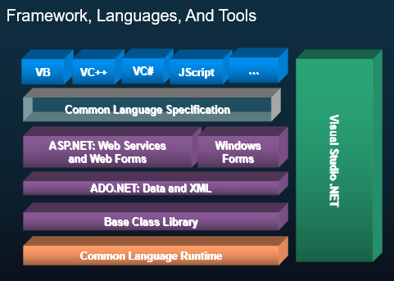
Framework, Languages and Tools

Slide 5
Insights on ASP.NET
It supports languages like VB.Net, C#, JScript .NET
Programming logic and content can be developed separately
HTML markup are kept in one file and the programming code in another file
Enables you to access information from data sources
back-end databases and text files that are stored on a Web server
Enriched tool support in the form of Visual Studio .NET integrated development environment
Manage Web applications by storing the configuration information in an XML file
web.config is used to manage various settings that define a website

Slide 6
Insights on ASP.NET - Contd
ASP.NET is an open-source server-side web application framework designed for web development to produce dynamic web pages developed by Microsoft to allow programmers to build dynamic web sites.
Minimized length of the code, Widely used for enterprise-level web applications
Reliable, fast, easy to use, free and widely known. ASP.NET gives full control of development and can be used on any project, big or small
Language-independent - Developer can develop in one of the many languages that target the .NET Framework like C#, C++/CLI, Eiffel, F#
Provides high level of performance - Tools provided by Microsoft can measure application performance. Can easily implement improvements to memory use, code throughput, and responsiveness

Slide 7
Versions of ASP.NET
Visual Studio is the recommended tool - includes almost everything needed to develop, test, and debug web applications
ASP.NET2.0,3.5,4.0,4.5, 4.7 frameworks - Visual Studio allows to create application in any of the mentioned version of framework.

Slide 8
ASP.NET Application Life Cycle

